Slide 1
Large Displacement Optical Flow Estimation Based on Warping
Saiwen W., Yifan S., Yijun P., Xinyuan Y.

Slide 2
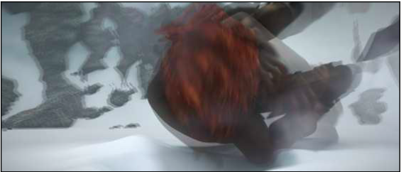
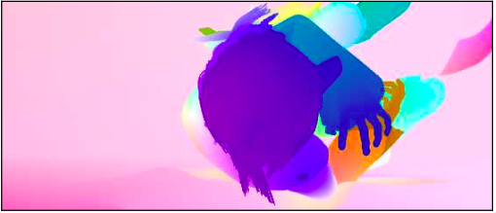
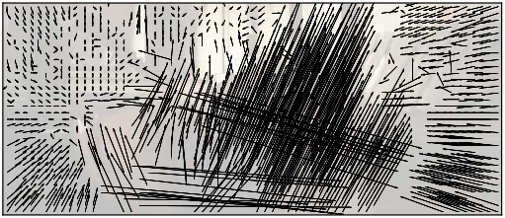
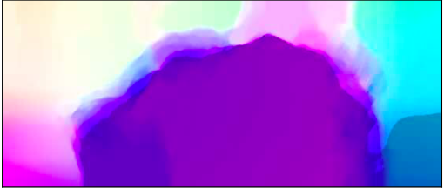
Problem
Find the relative displacement of each pixel in a given pair of images.

Slide 3
Algorithm
DeepFlow: Large displacement optical flow with deep matching
Philippe Weinzaepfel, Jerome Revaud, Zaid Harchaoui and Cordelia Schmid,
Proc. ICCV‘13, December, 2013.
Module implementation (in C): can be easily adapted to other algorithms.
DeepFlow: Original implementation published with the paper. (Easy baseline.)
FastDeepFlow: Up-to-date optimized code. (Hard baseline.)

Slide 4
Theory
Data Term
Matching term
Smooth term

Slide 5
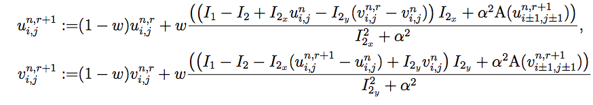
Theory
Non-convex and non-linear -> incremental coarse to fine warping strategy with down sampling.
Three loops
Outer loop: Move along the image pyramid.
Middle loop: outer layer fixed point iteration -> update flow increments and non-linear weight iteratively.
Inner loop: inner layer fixed point iteration -> Use successive over-relaxation method to approximate the solution.

Slide 6
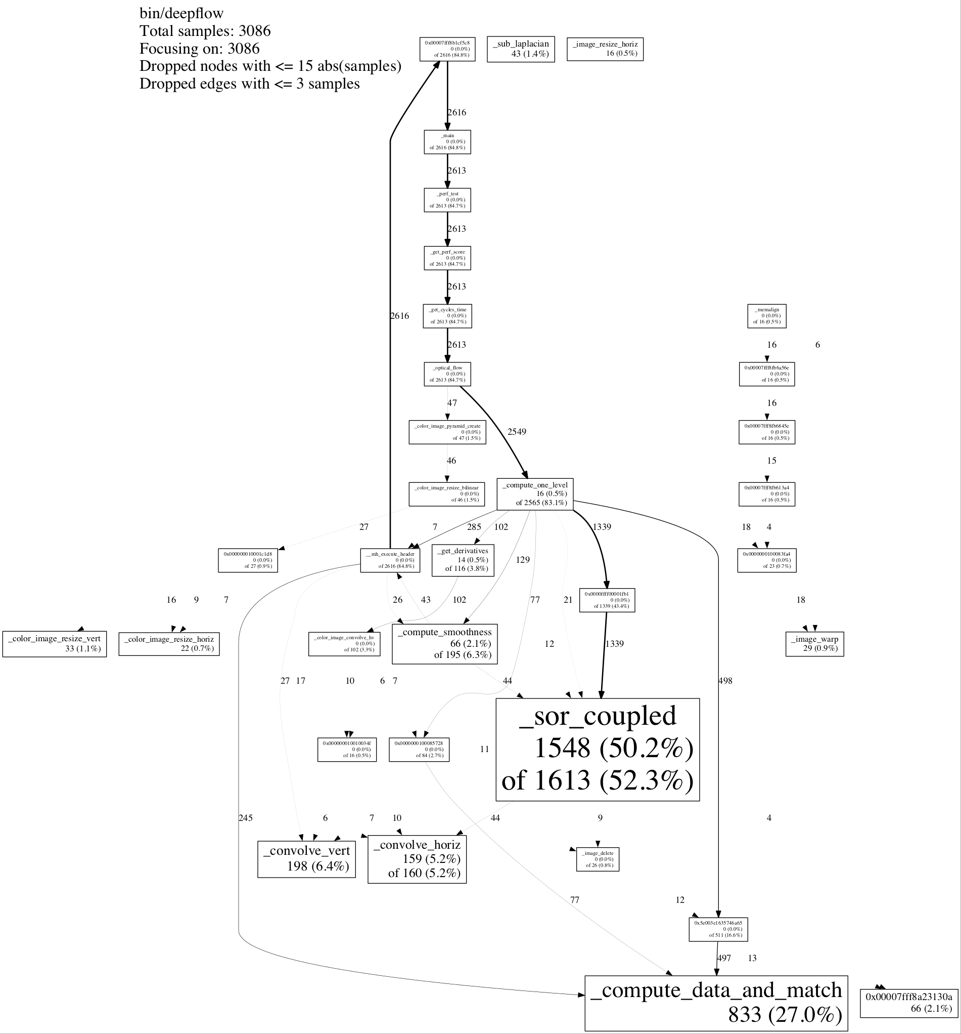
Bottlenecks
Using google profiler
Two functions:
Solver
Computer data and match

Slide 7
Result Validation
Using diff to compare the original version of the flow file and the newly generated file from optimized version

Slide 8
Performance Measurement
With M, N as the height and the width of the input image.
Measurements:
Additions
Multiplications
Divisions
Square root

Slide 9
Basic Optimizations
Precomputing duplicated computations.
Scalar replacement to lower the memory access pressure
Blocking to lower the memory access pressure and discover spatial locality

Slide 10
Performance Plots

Slide 11

Performance
Solver
Cost 41MNK_{i}K_{m}K_{o} flops
Data 84MNK_{i}K_{m}K_{o} bytes
Operational intensity 0.48 $Θ(1)$
Compute data and match
Cost 263MNK_{m}K_{o} flops
Data 136MNK_{m}K_{o} bytes
Operational intensity 1.96 $Θ\left(1\right)$

Slide 12
Runtime Plots

Slide 13
Next step
Using SSE to vectorization code
Cache analysis
Changing flags
Roofline analysis

